Slide 1
Working at a Start-Up
David Thielen
CEO/Founder – Windward Studios

Slide 2
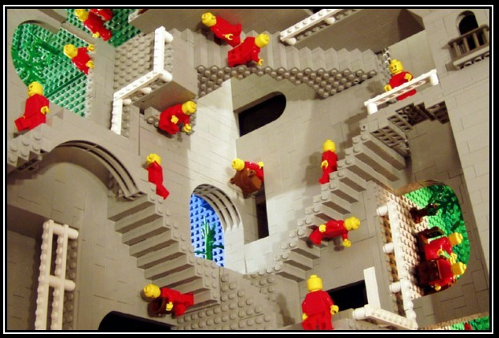
Here We Go…
Who’s This Old Guy?
General Advice
Working at a start-up
  Lots of stuff…
  What to look for
  What not to look for
Founding a start-up
Being the CEO at a start-up
Questions
  And if you’re lucky - answers

Slide 3
Who’s This Old Guy?
My experience includes
  3½ years at Microsoft – senior developer on the Windows team
  Designer & lead developer on the game Enemy Nations
  Founder & CEO of Windward Studios
  Over 40 years programming in Fortran, Pascal, C, C++, Assembler, Java, C#, & JavaScript.
    Starting with punch cards
CTO at numerous start-ups
Written three technology books
Graduated from C.U. – Physics & Math
  I took 1 programming course at C.U. – basically I’m self-taught

Slide 4

General Advice
Do what you’re good at
  Your brain is wired differently.
  The things that come easy – that’s what you can excel at
Take the more interesting path
  Screw what others see as the
  common path
  Listen, evaluate, but don’t let the
  conventional wisdom guide you

Slide 5

Working at a start-up
We are in a time of rapid acceleration
  This gives you a massive opportunity
You will fail. A lot.
Everyone will see your successes and your failures.
It’s up to you.
You need to be a fox, not a hedgehog
  There are some rare exceptions to this
It will take everything you’ve got, and then some.
Get it done.
  Ignore limits, but don’t ignore physics

Slide 6
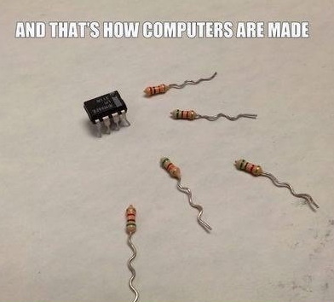
How Start-Ups Hire
Internship experience
  You must have this.
Your projects
  Throughout your time here.
Your classes
  The grounding you have is critical.
Hackathons
  Shows that you love programming.

Slide 7
What matters – in priority order
Dependable & Collaborative
Communication
  Blog, speak, write. About anything.
UX
Programming
  Beautiful elegant code
Ideas

Slide 8
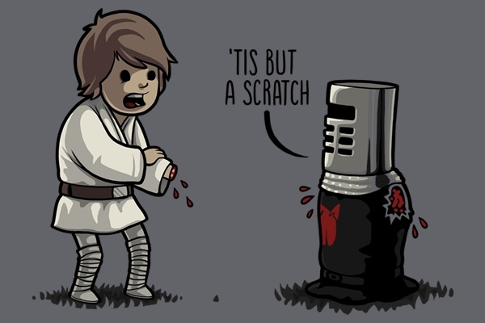
What to Look For
How good the team is
  You want a challenge
The culture
  Work will consume you. It must be a place you love.
Their goal
  Is it something that you are willing to give everything to?
  Doesn’t have to be the product, it can be the people.
Free soda pop
  Really good indicator of a place that values its employees
Notes:
TJ – “I also would have thought the part about free soda was a joke, but it's incredible how accurate I've found that to be”

Slide 9
What Not to Look For
What product they are creating
What technology they use
The pay
Notes:
Not is a strong word but these items are unimportant compared to figuring out what you want to go do.
TJ example – really liked the idea of sysadmin. After 9 months as one learned he hated yet. Fredy after 9 months loves it.

Slide 10
What you Should Ask
Your questions demonstrate what matters to you
  It’s a valuable data point to the hiring company
Show intellectual curiosity
  What will I be working on?
  Will I be challenged?
Show an understanding of business (we need to make a profit)
  How will my work impact the product?
  What would be a game changer for the product?
Ask the interesting questions.

Slide 11

But I Don’t Like Programming…
There are numerous jobs that require programming knowledge
  QA
  Sales Engineer
  System Administrator
  Program Manager
  Product Manager
  Sales
  Marketing
  CEO

Slide 12
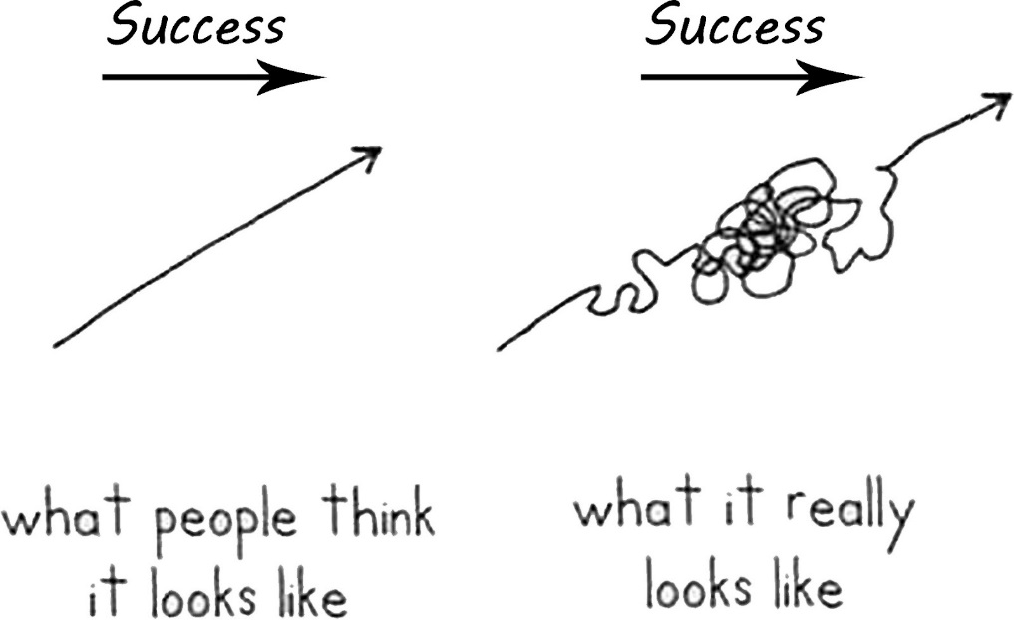
Founding a Start-Up
Fundamentally an insane decision
Follow your dreams
Be original, create a monopoly
Culture eats strategy for breakfast

Slide 13
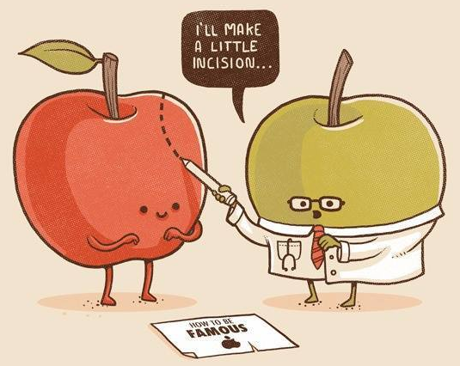
CEO at a Start-Up
There is no way to train for this
  Read “The Hard Thing About Hard Things”
You must use what is special about you –
otherwise you're f----d.
Who you hire, how you manage them is everything
  Hire for strength, not to avoid weaknesses
Every time you grow 3X, everything no longer works
The first rule of CEO psychological meltdowns is…
  No one talks about CEO psychological meltdowns
Find mentors

Slide 14
Questions?
david@windward.net
Everyone who's ever taken a hot shower has an idea. It's the person who gets out of the shower, dries off and does something about it who makes a difference.
-- Nolan Bushnell
Tell me how I did
http://rpt.me/CU_survey

