Slide 1
Want to be a better developer?
CHEAT!
David Thielen
Founder Windward Studios

Slide 2
Tips & Tricks that make a giant difference
The suggestions are in order of effectiveness
These are tricks that make you more effective & efficient
Nothing magic, it’s just simple approaches to how you work
The url to these slides is provided at the end

Slide 3
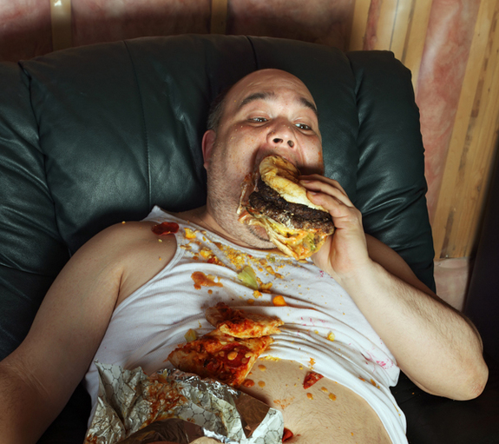
Want to lose weight?
Eat less
Exercise more

Slide 4
If I could make one change
No interruptions
  It takes a programmer 45 minutes to get back in the zone after an interruption, even a 30 second one.
  If left alone, the average programmer will work for over 4 hours before coming up for air.
Peopleware by Tom DeMarco
Offices for each developer
  Cubicles are evil.
Don’t multi-task – everyone sucks at it
  If you have multiple projects, complete one then start the next
  For secondary projects, restrict when you work on them

Slide 5
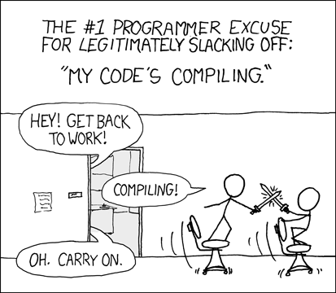
What no interruptions means
Facebook is not open
Slack is not open
Twitter is not open
Your phone does not ring
Your email is closed or disconnected
  Check just 2 or 3 times/day.
There is no clock on your desktop
When you’re compiling, stare at the wall

Slide 6
First two four hours
The first 2+ hours of the day is by far your most productive time
  This works!
Do not start the day on the little crap, the catch up, your email, etc.
  These items don’t benefit from happening during this time
Come in fresh each day sit down and work on the big hard work
  You will double or better what you accomplish
  Your design & code will be superior
To do this right
  Don’t give any thought, effort, time to anything else beforehand
  Don’t have anything that can interrupt you active
  The rest of the world doesn’t exist

Slide 7
No Music
Listening to music stops you from seeing better approaches.
It’s deadly because you don’t know what you missed.
Homework:
  With music on solve the problem at codingbat.com/prob/p183562 – 5 minutes max.
  Take a 1 minute break to check email or something that drops it from your mind.
  Now with music off and no other interruptions or distracting noises, work on it again – 5 minutes max.

Slide 8
Procrastinate
Especially when you architect!
  Always, always, always.
Give your brain a chance to work on it after you leave work
Get the idea when you’re out – immediately email it to yourself
Have a notepad & pen by the bed – and write it down immediately
  Remembering in the morning that you had a great solution – and forgot it – not good.
And sometimes it doesn’t work, and then you need to use the best you came up with.

Slide 9
The Best Programmers are…
Lazy
  Find the quickest/easiest solution.
  Ask others how to solve the problem.
    Let Google, StackOverflow, & MSDN do your work for you.
      If you can’t find an answer – ask.
  Do as little as possible.
  Provide a C- solution when appropriate. Not everything deserves an A+.
Intense Focus
  Issac Newton’s strength was his focus, others were as smart
K.I.S.S.
Write code that is elegant in its simplicity
  If you can’t think of a clean solution, go swimming

Slide 10
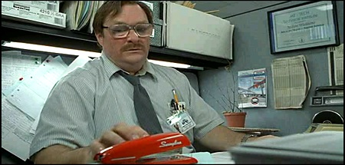
The best equipment
Dual monitors (at a minimum, 3 is better)
  Large dual monitors
Screaming fast multi-core computer
Tons of RAM
SSD (with hard drive for VMs)
Use Visual Studio – get ReSharper
Use Java – get IntelliJ
Writing in JavaScript – use TypeScript & WebStorm

Slide 11

TRAPs
This is different from code coverage.
Add to your code "trap()" and "trap(bool)"
Place it at:
  The start of every method
  The start of every if, else, & while
The trap drops you into the debugger.
This helps you single step through all your code the first time.
This lets you know when you’re hitting a new code path for the first time.

Slide 12
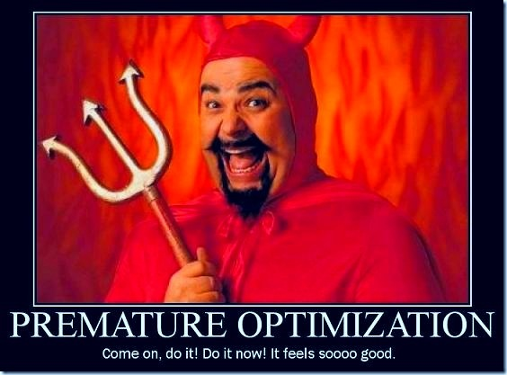
Optimize early only where you must
There are cases where early optimization is worth it.
  A change would require a rewrite in 10s – 100s of places.
  A profiler won’t show the hit.
  JavaScript example that fits both of the above criteria.
The rest of the time, wait.
  You may later eliminate that optimized code.
  You may find it’s rarely called.
  No one may buy the product.

Slide 13
Unit Tests
Not everything deserves a unit test!
  Again, not all code is worthy of a test.
Not every unit tests deserves to be comprehensive
On a bug
  Write the test (it fails)
  Fix the bug.
  Run the test (it passes)

Slide 14
Drop into the debugger for all exceptions
Set the debugger to stop on handled exceptions.
  Often it means something is going wrong.
  It encourages you to have no exceptions in the happy path.
Java – you can’t (the runtime throws tons of exceptions)
Visual Studio – check “Just my code”

Slide 15
Miscellaneous
When you leave each evening, leave yourself a note of where you are for the next morning.
Write the comments when you write the code
  By the next day you’ve forgotten half of what you should write.
  Write your intent first, your approach second. The code itself shows how you implemented it.
I’ve never seen a variable name that was too descriptive.
Minimize meetings, reports, etc. Some are critical, some are useful, many are a waste of time. And always, GTTFP.
When you have a question for a co-worker – always send email.
  That’s the only way they’ll do the same.
For logging, always use "if (log.IsDebugEnabled)"

Slide 16
Questions?
You can reach me at:
  david@thielen.comt
  My blog: Code Snippets
  LinkedIn

